Slide 1
How to Predict Bodyfat
Tuesday Group 2
GUANQI LU, YI-HSUAN TSAI, HAOXIANG WEI, QIAOCHU YU

Slide 2
INDEX
WHAT IS BODYFAT
DATA PRE-PROCESSING
MODEL BUILDING
RULE OF THUMB
PROS AND CONS

Slide 3
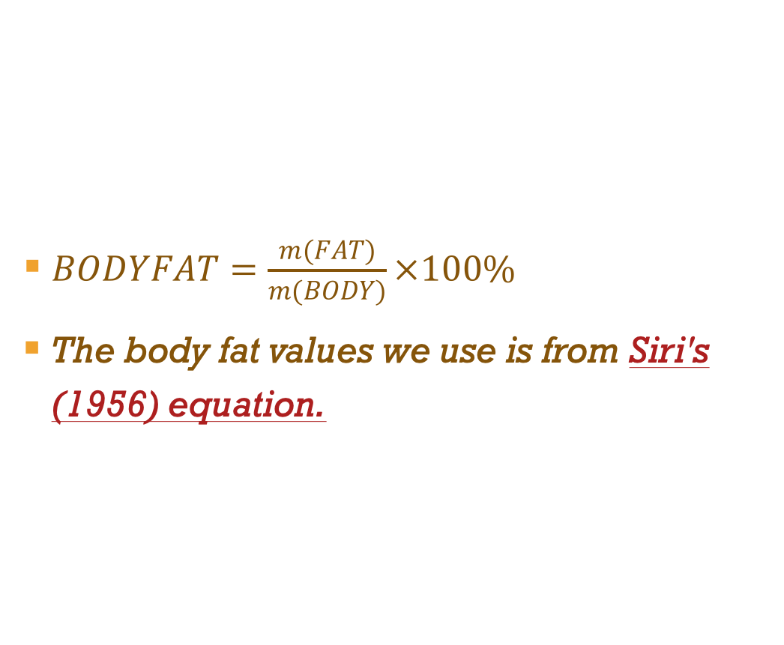
WHAT IS BODYFAT
$BODYFAT=\frac{m(FAT)}{m(BODY)}×100\%$
The body fat values we use is from Siri's (1956) equation.

Slide 4
Siri's (1956) equation
Assume that the body consists of two components - lean body tissue and fat tissue.
D = Body Density (gm/cm^3)
A = proportion of lean body tissue
B = proportion of fat tissue (A+B=1)
a = density of lean body tissue (gm/cm^3)
b = density of fat tissue (gm/cm^3)
Solving for B we find
B = (1/D)*[ab/(a-b)] - [b/(a-b)].

Slide 5
DATA PRE-PROCESSING
Use the linear relationship between density and bodyfat(Siri’s equation), BMI formula, cook‘s distance to find out abnormal observations.
Delete those observations.
Scale the variables.

Slide 6
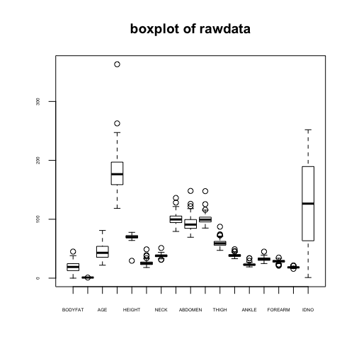
Boxplot
An obvious outlier with extremely large weight. (No. 39)
Need to normalize the data, for they are of totally different scale.

Slide 7
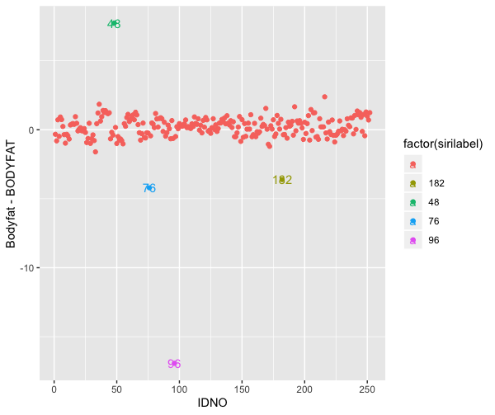

Siri’s equation
$$Bodyfat=\left(\frac{495}{Density}−450\right)∗100\%$$
No. 48, 76, 96, 182

Slide 8
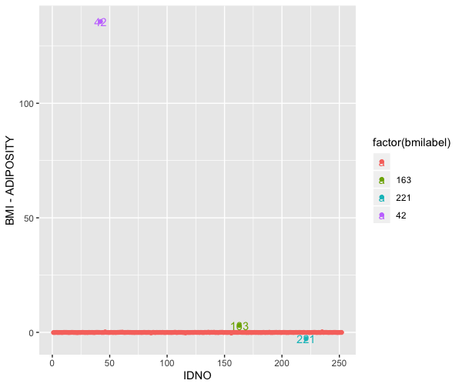
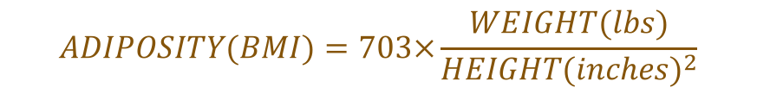
BMI formula
$$ADIPOSITY(BMI)=703×\frac{WEIGHT(lbs)}{{HEIGHT(inches)}^{2}}$$
No. 42,163, 221

Slide 9
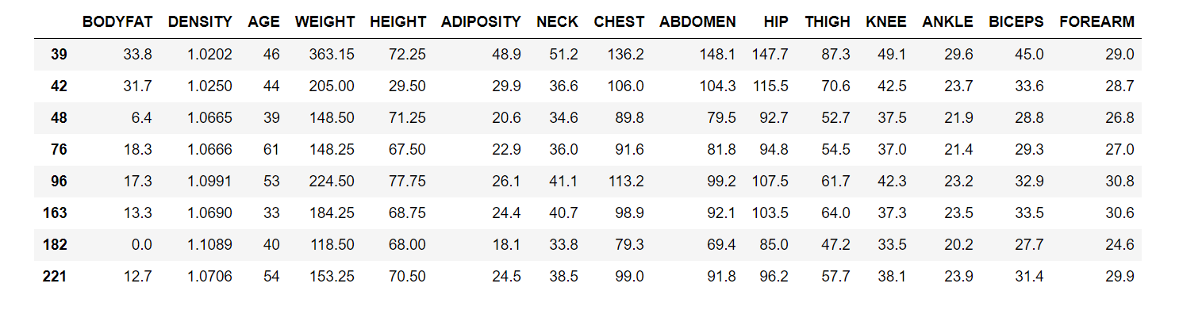
Outliers
39 has too large size.
Obervations 48, 76, 96, 182 do not match the relationship between bodyfat and density (i.e. Siri’s equation).
Obervations 42,163, 221 do not match the BMI formula.

Slide 10
Model Building
Variable selection
PCA (hard to interpret and use)
CART decision tree (dataset is too small)

Slide 11
Variable Selection
Stepwise selection(AIC,BIC), Mallow's cp, and lasso.
AIC backward: BODYFAT ~ AGE + ADIPOSITY + NECK + ABDOMEN + HIP + THIGH+FOREARM + WRIST
AIC forward/both sides: BODYFAT ~ ABDOMEN + WEIGHT + WRIST + BICEPS
BIC forward/backward/both sides: BODYFAT ~ ABDOMEN + WEIGHT + WRIST
Mallow's cp: BODYFAT ~ AGE + WEIGHT + HEIGHT + +ADIPOSITY + NECK + ABDOMEN + HIP + THIGH + BICEPS + FOREARM + WRIST
Adjusted R square: BODYFAT~AGE +WEIGHT+ HEIGHT +ADIPOSITY+NECK+CHEST+ ABDOMEN +HIP+ THIGH+BICEPS+FOREARM + WRIST
Lasso: BODYFAT ~ AGE + HEIGHT + ABDOMEN + WRIST

Slide 12
WRIST or WEIGHT
ABDOMEN is the most important predictor beyond doubt, followed by WRIST and WEIGHT.
Model 1: BODYFAT ~ ABDOMEN + WEIGHT
Model 2: BODYFAT ~ ABDOMEN + WRIST
 | Model 1 | Model 2
Correlation coefficient | 0.603 | 0.873
VIF test | 4.194 | 1.572

Slide 13
RULE OF THUMB
BODYFAT = 0.73*ABDOMEN - 2.03*WRIST - 11.2

Slide 14
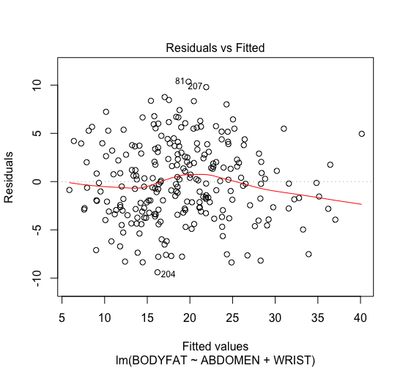
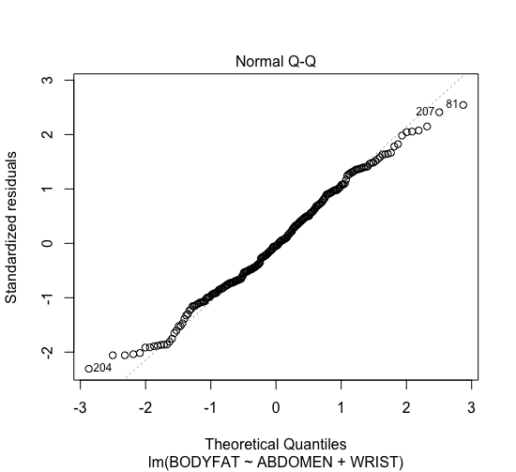
Diagnostics

Slide 15
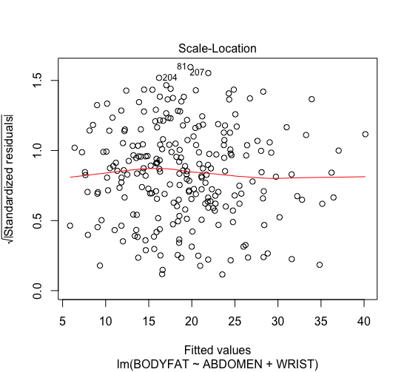
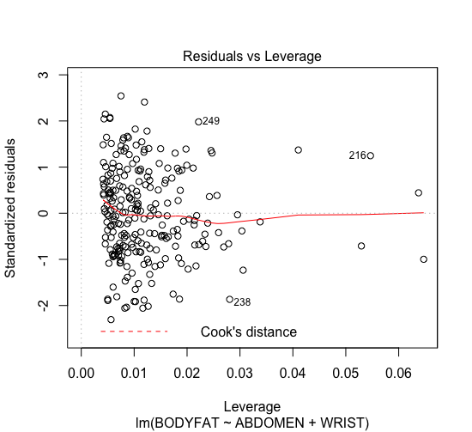
Diagnostics

Slide 16
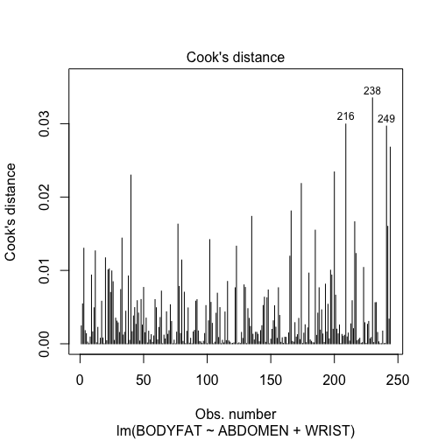
Diagnostics

Slide 17
PROs and Cons
Our final model is simple and straightforward. The variables included for prediction is easy to get.
The model is robust.
The model is accurate as the adjusted R-squared is greater than 0.6.
We only consider two variables and ignored the interaction between these variables.
Our data sample only contains 252 observations, if the weight is too hig or too low, the predic- tion may not be so accurate.

Slide 18
THANK YOU FOR WATCHING

